Slide 1

IMS week 5 project
Luke Edwards

Slide 2
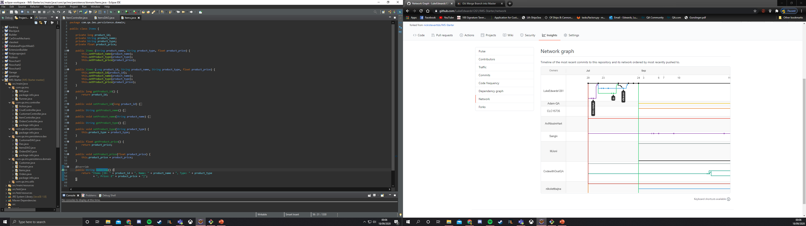
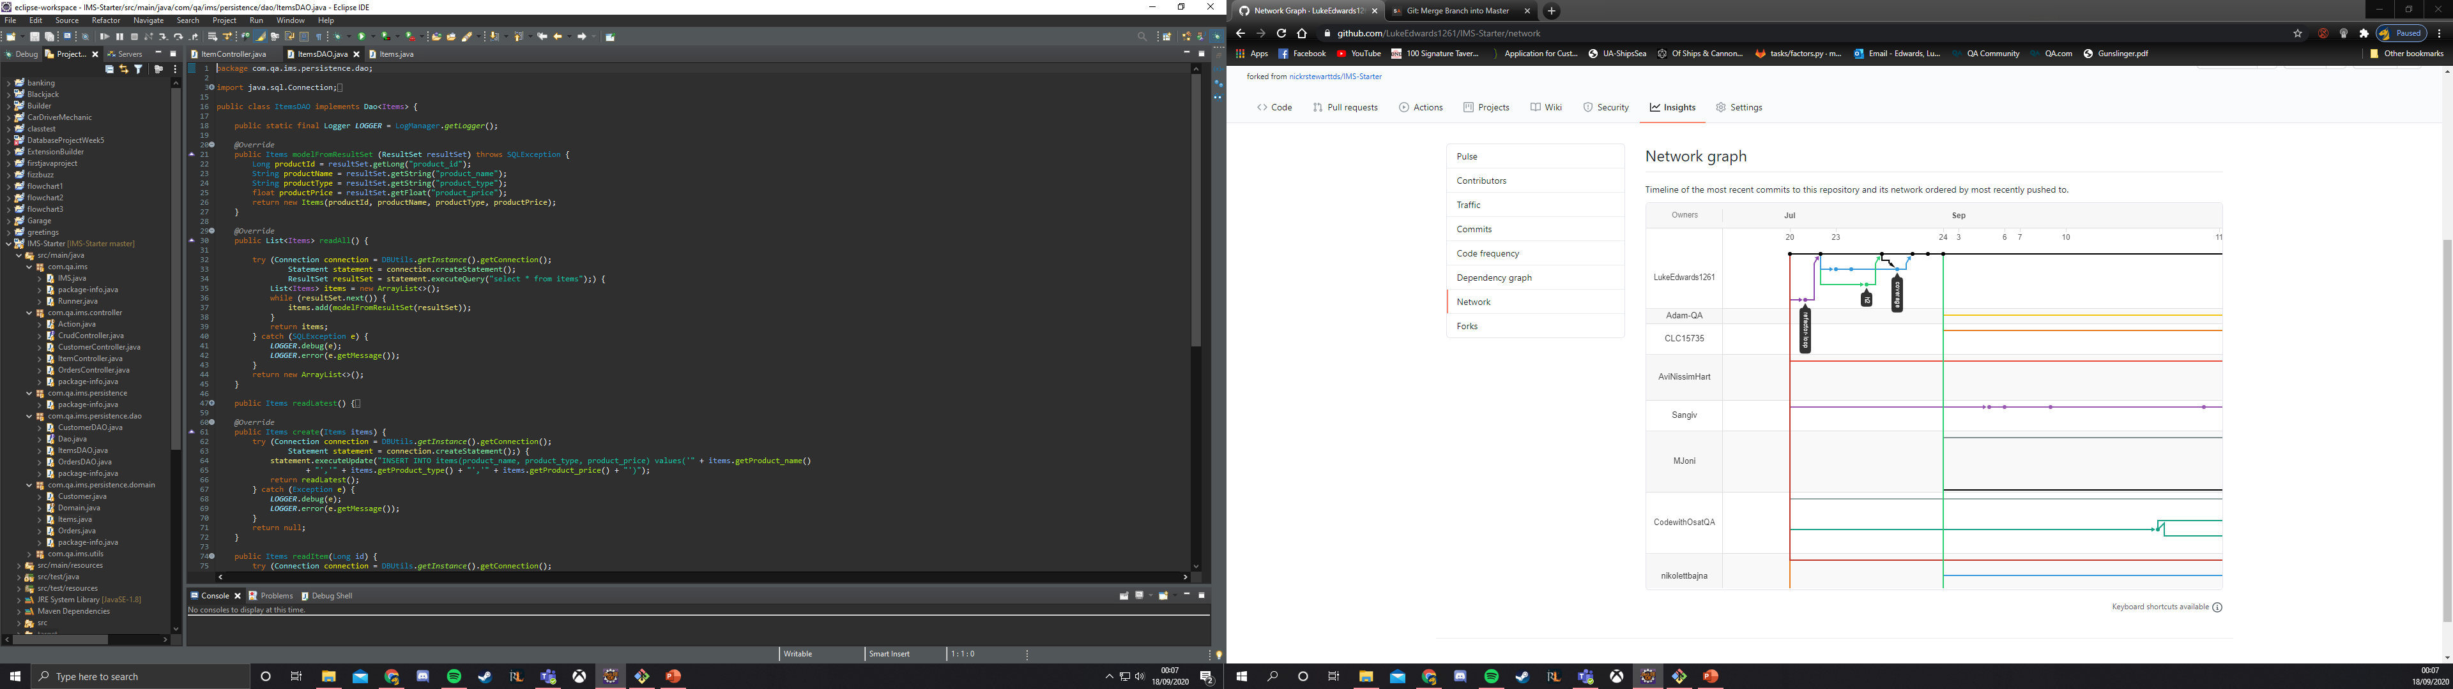
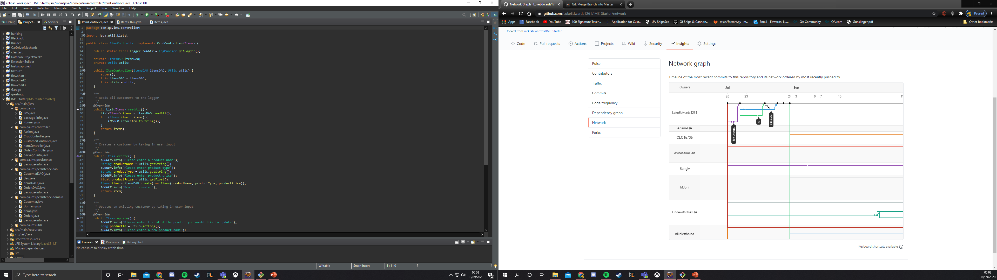
Application design
The Maven Java project has been devided into 3.5 sections in order to manage each of the sections: Customers, Items, and orders within the application, each section corresponds with a table within the command line interface (mysql) these tables are linked with one to many, or many to many relationships.
Items: This Contains the getters and setters, and ToString to interact with the console
ItemsDAO: the DAO is used to interact with mySQL database
ItemsController: This is used to translate inputs from the console over to the DAO

Slide 3
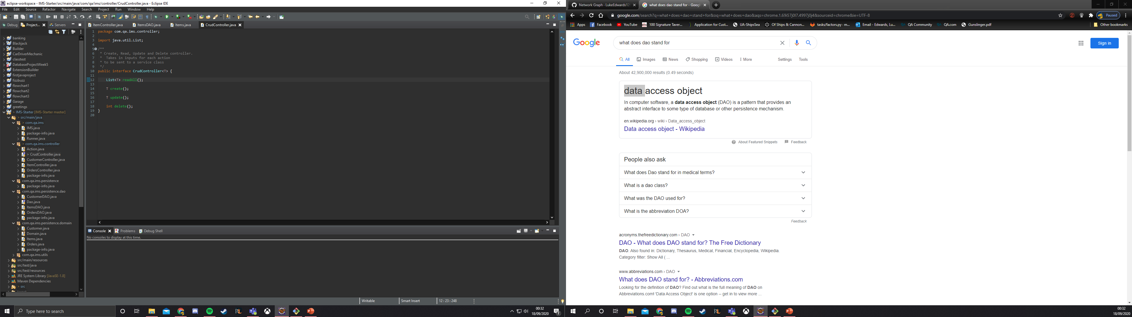
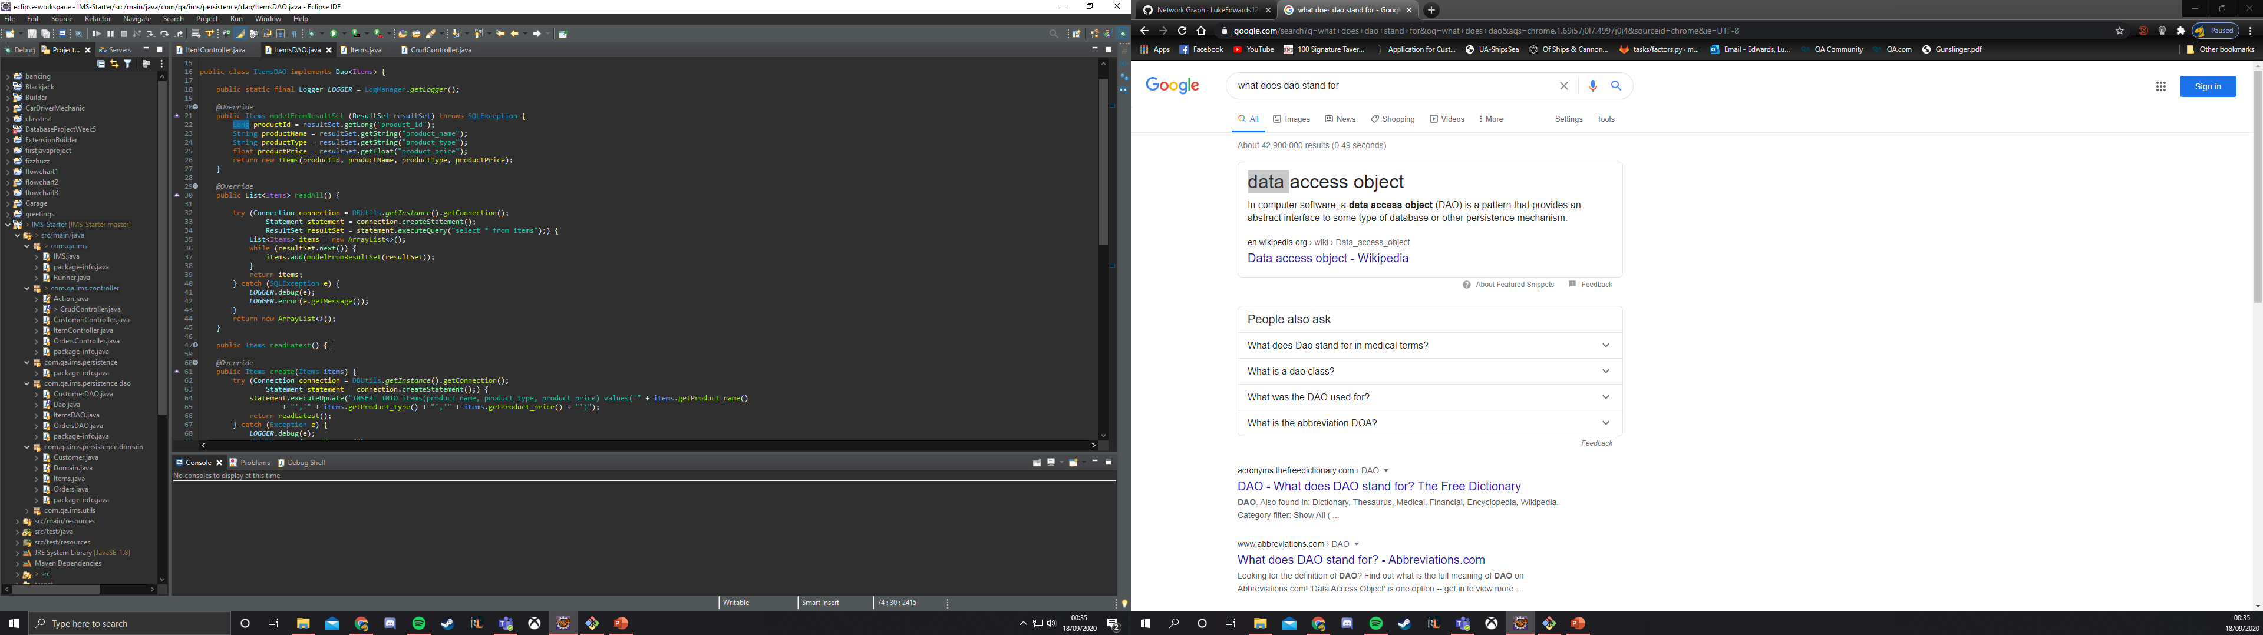
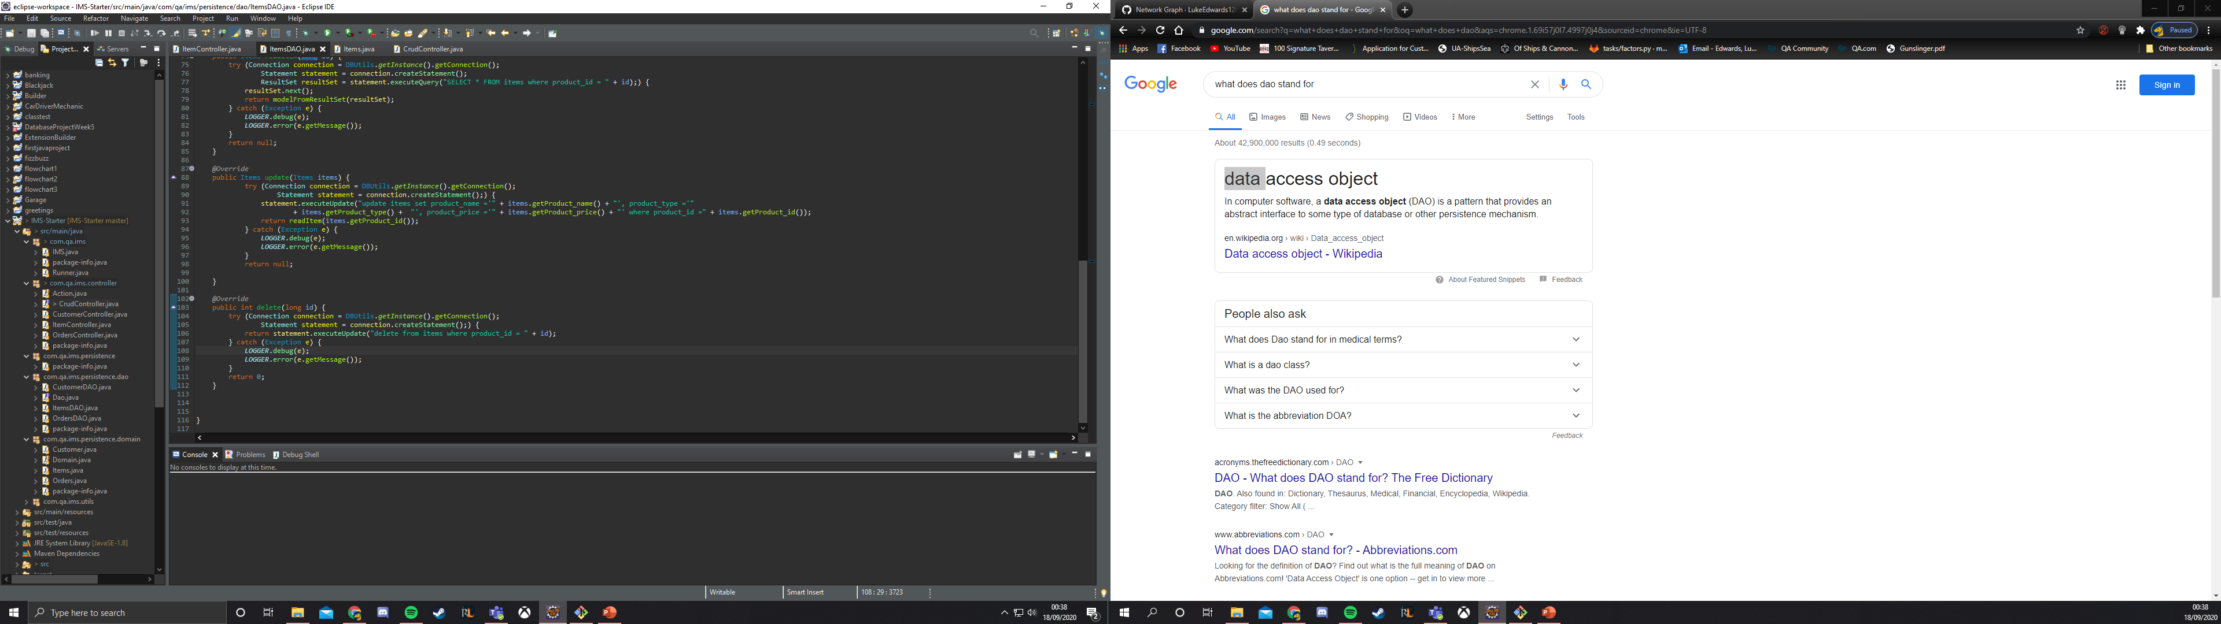
CRUD
Each section (Items, customer, orders) has CRUD methods to create, remove, update, and delete each of the SQL tables:

Slide 4
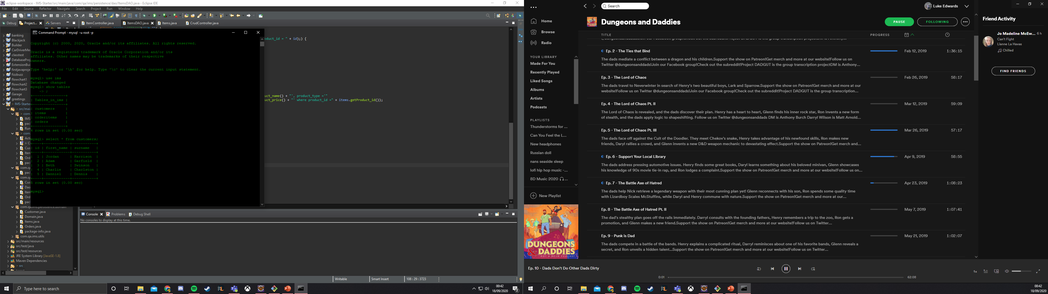
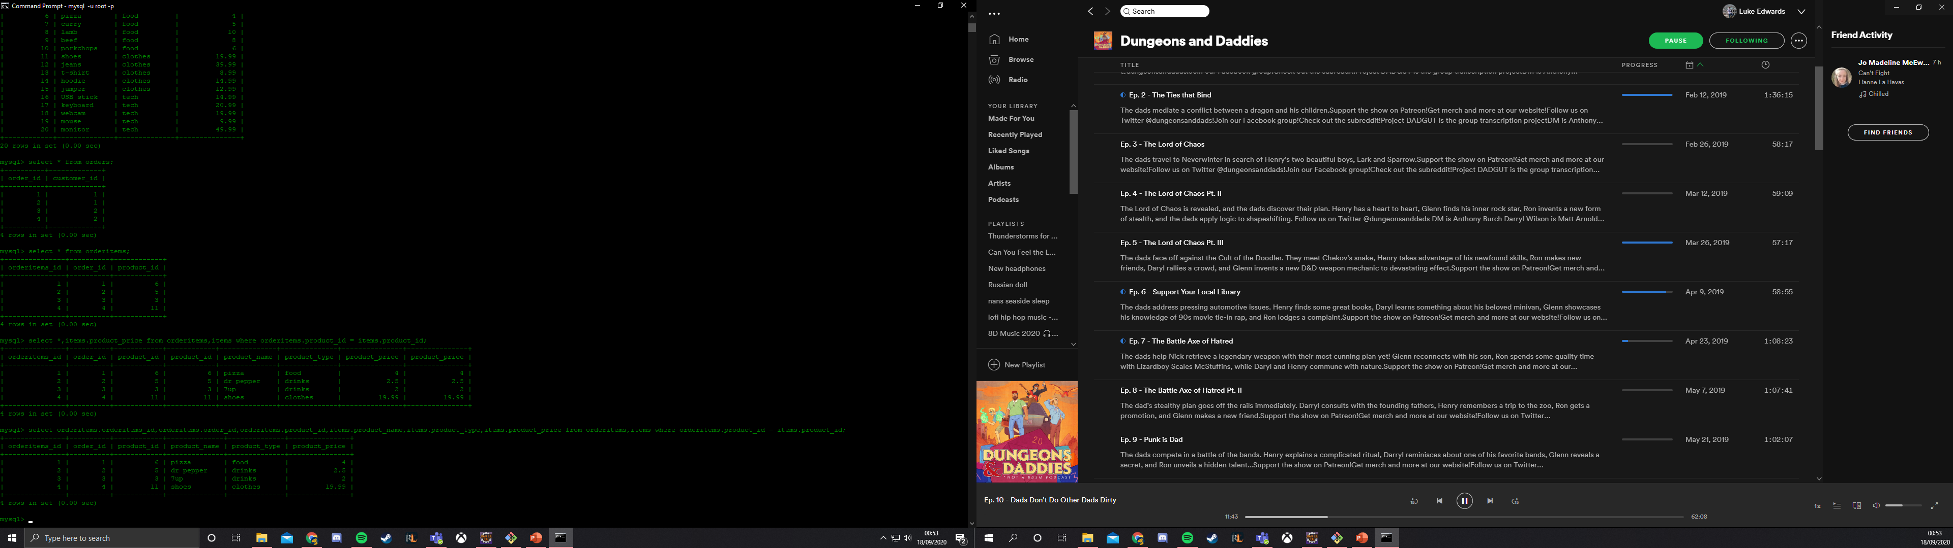
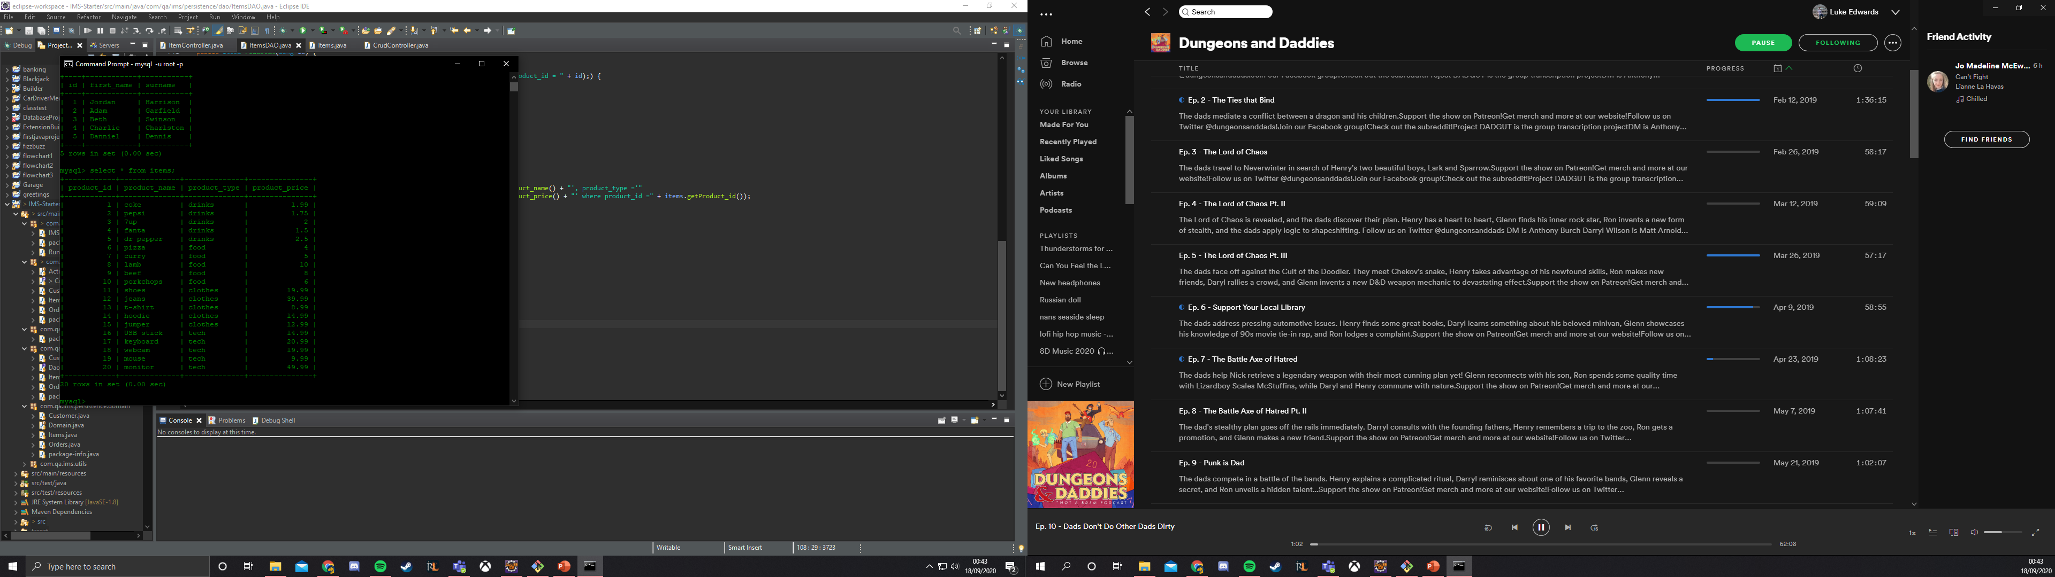

CMD
4 tables are created using the application: customers, items, orders and orderitems
Orderitems is used to link together orders and items in a many to many relationship

Slide 5
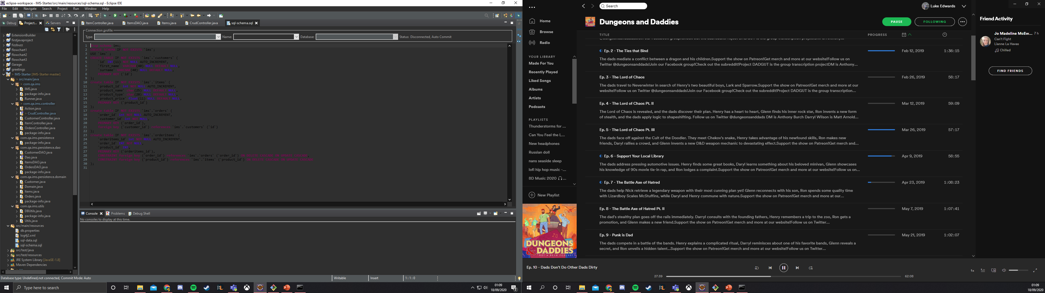
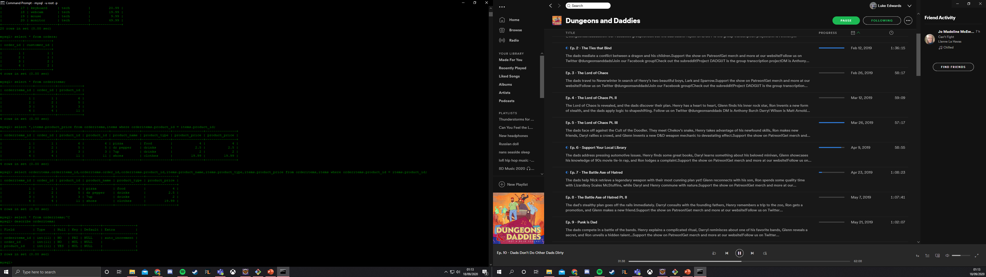
ERD

Slide 6
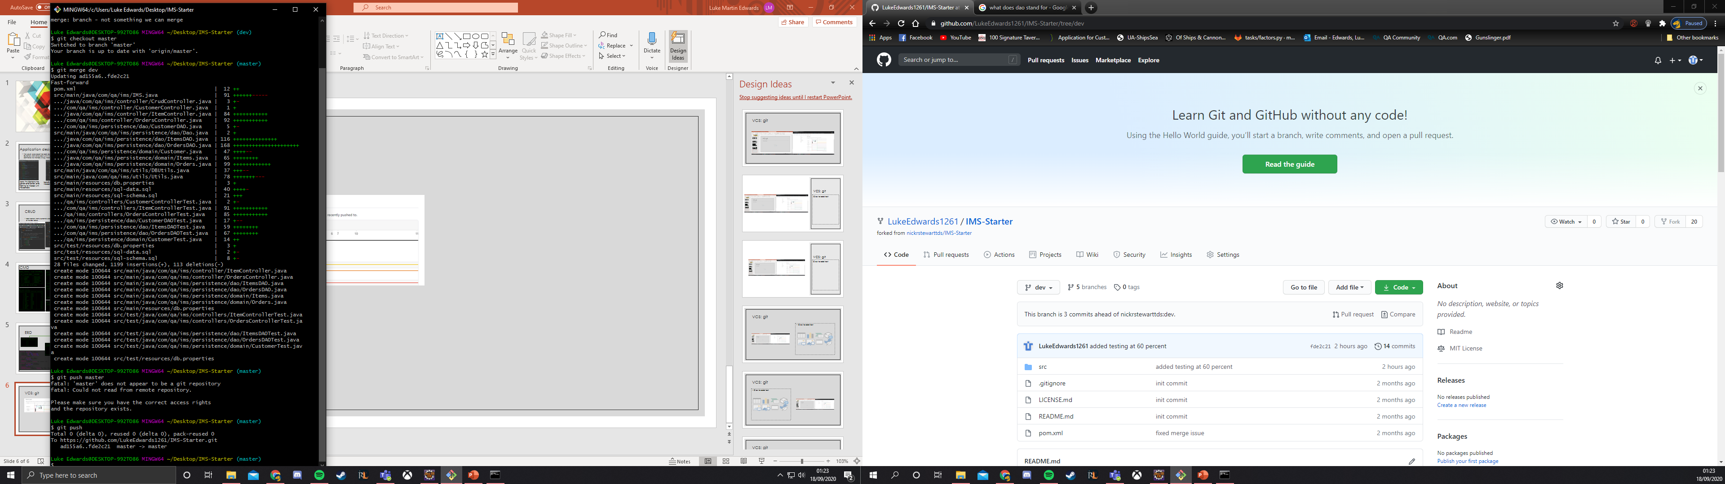
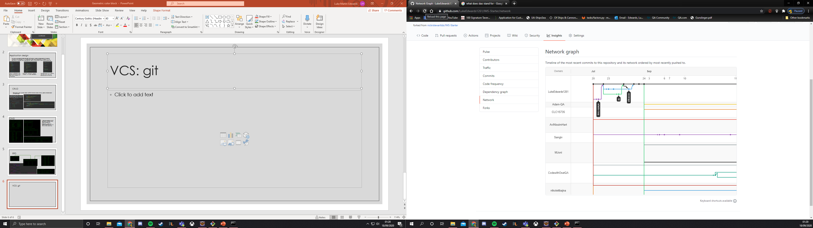
VCS: git
The version control system GitHub was used to manage the project, a dev branch was split from the master branch and was committed + pushed to the dev branch at the end of each day when the project was in a stable state, at the end of the project the dev branch was merged back into the master branch

Slide 7
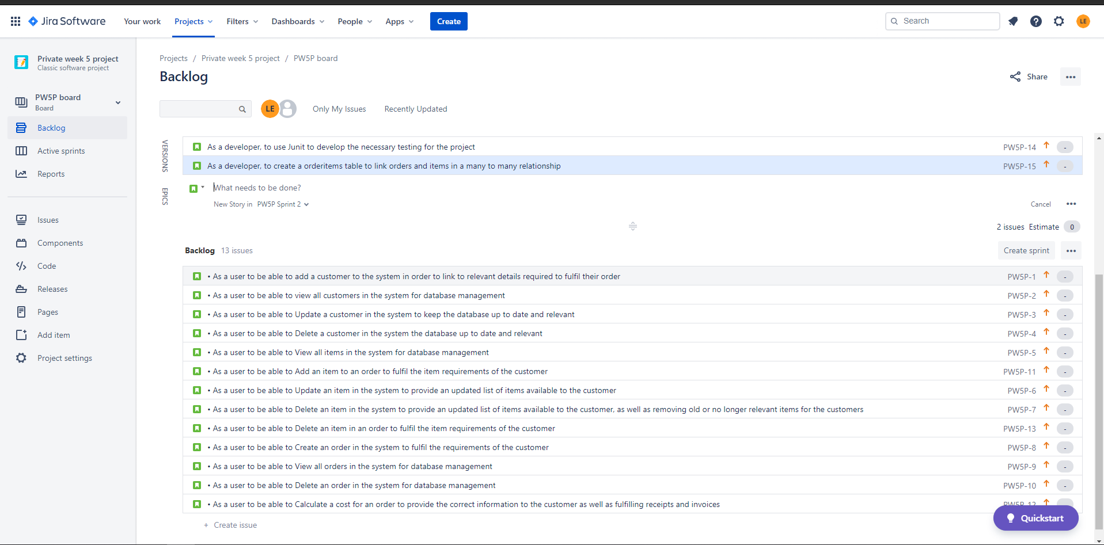
Jira: agility board & project management
Jira was sparingly used for the development of the project, for a single user in a short period it wasnt truly required, however Jira would have much greater use for a project with multiple users and could be used to assign tasks to individuals within the project, especially for longer projects that span multiple sprits which Jira accommodates for.
In this case Jari is suitable for creating tasks such as “as a user to be able to view all customers in the system for database management” and “As a developer, to use Junit to develop the necessary testing”

Slide 8
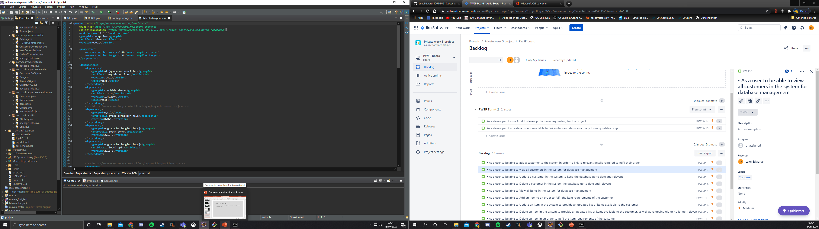
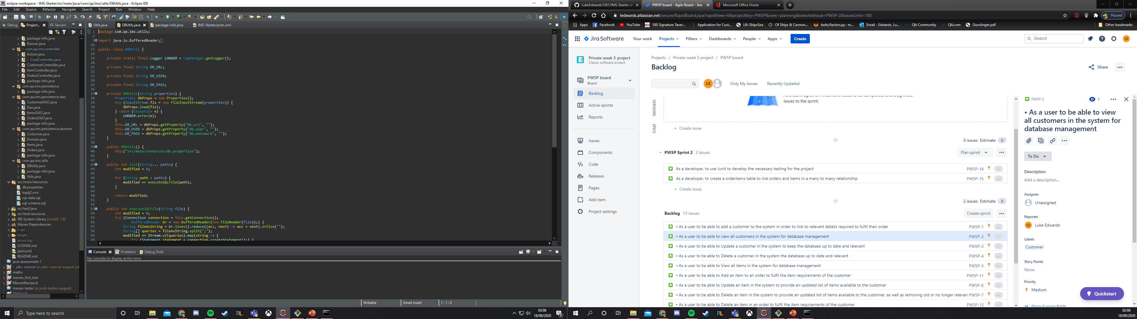
Build tool: Maven
Maven is used to build and package the project, as well as include all the necessary utilities (utils) which allows the project to function

Slide 9
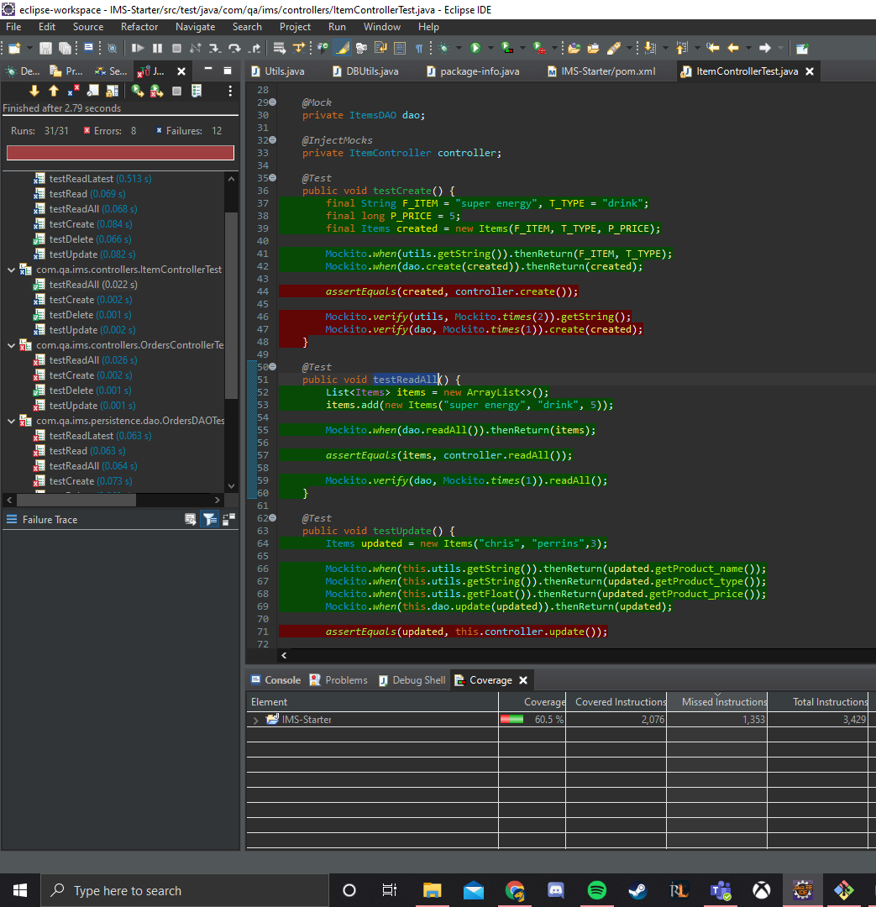
Unit testing: Junit
After the project was completed work was started on the testing side in a red-green fashion
Reaching a coverage of 60.5% given the time remaining

Slide 10
SOLID
S: Each class were created to serve one purpose each
O: classes were open to modification with the uses of overrides, however the variables were created privately to prevent modification (ie private long product_id;).
L: not applicable in this case as inheritance is not used.
I: Interfaces are separated as to not include methods that are not specifically needed for that function.
D: Hierarchy has been maintained for dependency, using interfaces where possible (dao and controller).

Slide 11
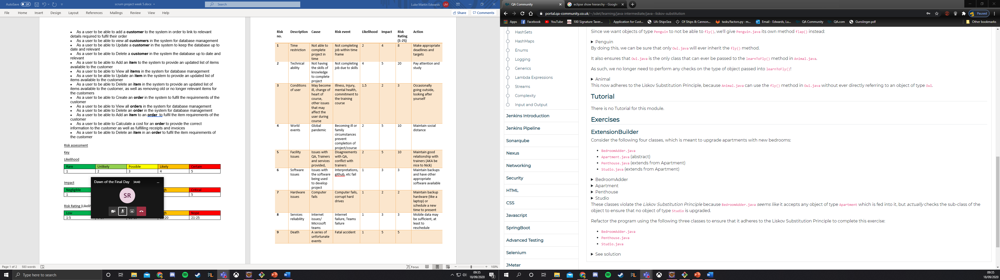
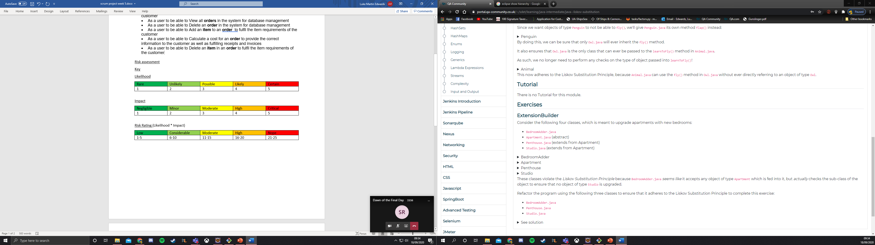
Risk assessment
A risk assessment has also been implemented to evaluate the risks of this project, this particular example was made before starting the project, with that in mind I would not evaluate time restriction and technical ability to be higher likelihood.

